Slide 1
Template-driven vs. Reactive Forms

Slide 2

Template- driven
Reactive

Slide 3

Module Overview
Angular Form Building Blocks
FormGroup
FormControl
Template Syntax for Forms Template-driven Forms Complex Scenarios

Slide 4
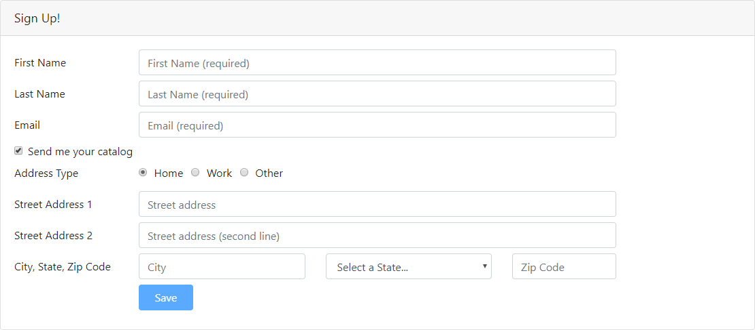

Slide 5
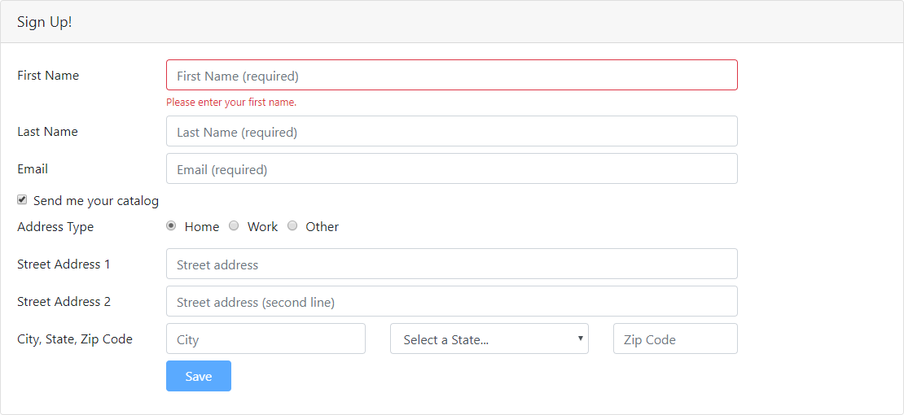

Slide 6
State
Value Changed
Validity
Visited
pristine
valid
touched
dirty
errors
untouched

Slide 7
Form Building Blocks
FormControl
FormGroup
<input id="firstNameId"
type="text" placeholder="First Name" required
minlength="3" />
<form (ngSubmit)="save()">
...
</form>

Slide 8
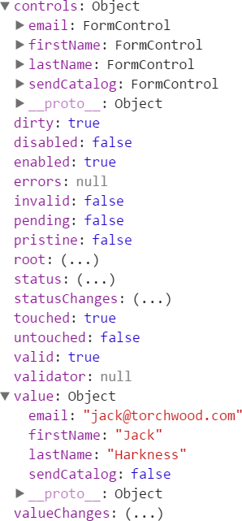
Form Model
Retains form state
Retains form value
Retains child controls
FormControls
Nested FormGroups

Slide 9

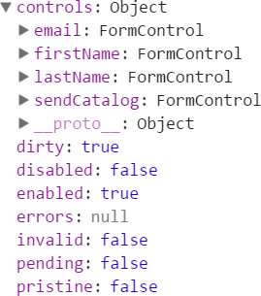

Template-driven Forms
Template
Form element
Input element(s)
Data binding
Validation rules (attributes)
Validation error messages
Form model automatically generated
Component Class
Properties for data binding (data model)
Methods for form operations, such as submit

Slide 10
Reactive Forms
Component Class
Form model
Validation rules
Validation error messages
Properties for managing data (data model)
Methods for form operations, such as submit
Template
Form element
Input element(s)
Binding to form model

Slide 11
Directives
Template-driven (FormsModule)
FormGroup
ngForm
ngModel
ngModelGroup
<form (ngSubmit)="save()">
</form>

Slide 12
Directives
Template-driven (FormsModule)
FormGroup
ngForm
ngModel
ngModelGroup
<form (ngSubmit)="save()" #signupForm="ngForm">
</form>

Slide 13
Directives
Template-driven (FormsModule)
FormGroup
ngForm
ngModel
ngModelGroup
<form (ngSubmit)="save()" #signupForm="ngForm">
<button type="submit"
[disabled]="!signupForm.valid">
Save
</button>
</form>

Slide 14
Directives
Template-driven (FormsModule)
FormGroup
ngForm
ngModel
ngModelGroup
FormControl
<form (ngSubmit)="save()">
<input id="firstNameId" type="text" [(ngModel)]="customer.firstName" name="firstName" #firstNameVar="ngModel"/>
</form>

Slide 15
Directives
Template-driven (FormsModule)
Reactive (ReactiveFormsModule)
ngForm
ngModel
ngModelGroup
formGroup
formControl
formControlName
formGroupName
formArrayName

Slide 16
HTML Form
customer.component.html
<form>
<div>
<label for="firstNameId">First Name</label>
<input id="firstNameId" type="text" placeholder="First Name (required)" required
minlength="3" />
</div>
...
<button type="submit">Save</button>
</form>

Slide 17
Template-driven Form
customer.component.html
<form (ngSubmit)="save()">
<div>
<label for="firstNameId">First Name</label>
<input id="firstNameId" type="text" placeholder="First Name (required)" required
minlength="3" [(ngModel)]="customer.firstName" name="firstName" #firstNameVar="ngModel"
[ngClass]="{'is-invalid': firstNameVar.touched && !firstNameVar.valid }" />
<span *ngIf="firstNameVar.errors"> Please enter your first name.
</span>
</div>
...
<button type="submit">Save</button>
</form>

Slide 18
Reactive Form
customer.component.html
<form (ngSubmit)="save()" [formGroup]="signupForm">
<div>
<label for="firstNameId">First Name</label>
<input id="firstNameId" type="text" placeholder="First Name (required)" formControlName="firstName"
[ngClass]="{'is-invalid': formError.firstName }" />
<span *ngIf="formError.firstName">
{{formError.firstName}}
</span>
</div>
...
<button type="submit">Save</button>
</form>

Slide 19
Demo
Template-driven Form

Slide 20
Demo
Template-driven Form: Template

Slide 21
Demo
Template-driven Form: Component

Slide 22





Complex Scenarios
Dynamically add input elements
Watch what the user types
Wait validation until typing stops
Different validation for different situations
Immutable data structures

Slide 23
Angular Forms
Template-driven
Generated form model HTML validation
Two-way data binding
Reactive
Manually created form model Validation in the class
No two-way data binding

Slide 24
Angular Form Building Blocks
Summary
FormGroup
FormControl
Template Syntax for Forms Template-driven Forms Complex Scenarios

